Slide 1
Cellular Networks
Wireless Networks Spring 2005

Slide 2
Cellular Network Organization
Use multiple low-power transmitters (100 W or less)
Areas divided into cells
  Each served by its own antenna
  Served by base station consisting of transmitter, receiver, and control unit
  Band of frequencies allocated
  Cells set up such that antennas of all neighbors are equidistant (hexagonal pattern)
Wireless Networks Spring 2005

Slide 3
Frequency Reuse
Adjacent cells assigned different frequencies to avoid interference or crosstalk
Objective is to reuse frequency in nearby cells
  10 to 50 frequencies assigned to each cell
  Transmission power controlled to limit power at that frequency escaping to adjacent cells
  The issue is to determine how many cells must intervene between two cells using the same frequency
Wireless Networks Spring 2005

Slide 4
Cellular Concept
Several small cells instead of a single transmitter=> frequency reuse: better efficiency
Fixed Channel Allocation:
Cluster of size N = i²+ij+j²; and D = sqrt(3N)R
R cell radius and
D distance at which a frequency can be reused with acceptable interference
Wireless Networks Spring 2005

Slide 5
Examples
Wireless Networks Spring 2005

Slide 6
Approaches to Cope with Increasing Capacity
Adding new channels
Frequency borrowing – frequencies are taken from adjacent cells by congested cells
Cell splitting – cells in areas of high usage can be split into smaller cells
Cell sectoring – cells are divided into a number of wedge-shaped sectors, each with their own set of channels
Microcells – antennas move to buildings, hills, and lamp posts
Wireless Networks Spring 2005

Slide 7
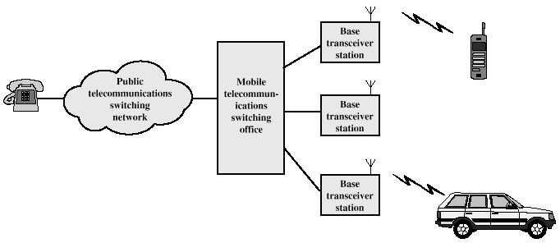
Cellular System Overview
Wireless Networks Spring 2005

Slide 8
Cellular Systems Terms
Base Station (BS) – includes an antenna, a controller, and a number of receivers
Mobile telecommunications switching office (MTSO) – connects calls between mobile units
Two types of channels available between mobile unit and BS
  Control channels – used to exchange information having to do with setting up and maintaining calls
  Traffic channels – carry voice or data connection between users
Wireless Networks Spring 2005

Slide 9
Steps in an MTSO Controlled Call between Mobile Users
Mobile unit initialization
Mobile-originated call
Paging
Call accepted
Ongoing call
Handoff
Wireless Networks Spring 2005

Slide 10
Additional Functions in an MTSO Controlled Call
Call blocking
Call termination
Call drop
Calls to/from fixed and remote mobile subscriber
Wireless Networks Spring 2005

Slide 11
Mobile Radio Propagation Effects
Signal strength
  Must be strong enough between base station and mobile unit to maintain signal quality at the receiver
  Must not be so strong as to create too much cochannel interference with channels in another cell using the same frequency band
Fading
  Signal propagation effects may disrupt the signal and cause errors
Wireless Networks Spring 2005

Slide 12
Handoff Performance Metrics
Cell blocking probability – probability of a new call being blocked
Call dropping probability – probability that a call is terminated due to a handoff
Call completion probability – probability that an admitted call is not dropped before it terminates
Probability of unsuccessful handoff – probability that a handoff is executed while the reception conditions are inadequate
Wireless Networks Spring 2005

Slide 13
Handoff Performance Metrics
Handoff blocking probability – probability that a handoff cannot be successfully completed
Handoff probability – probability that a handoff occurs before call termination
Rate of handoff – number of handoffs per unit time
Interruption duration – duration of time during a handoff in which a mobile is not connected to either base station
Handoff delay – distance the mobile moves from the point at which the handoff should occur to the point at which it does occur
Wireless Networks Spring 2005

Slide 14
Handoff Strategies Used to Determine Instant of Handoff
Relative signal strength
Relative signal strength with threshold
Relative signal strength with hysteresis
Relative signal strength with hysteresis and threshold
Prediction techniques
Wireless Networks Spring 2005

Slide 15
Power Control
Design issues making it desirable to include dynamic power control in a cellular system
  Received power must be sufficiently above the background noise for effective communication
  Desirable to minimize power in the transmitted signal from the mobile
    Reduce cochannel interference, alleviate health concerns, save battery power
  In SS systems using CDMA, it’s desirable to equalize the received power level from all mobile units at the BS
Wireless Networks Spring 2005

Slide 16
Types of Power Control
Open-loop power control
  Depends solely on mobile unit
  No feedback from BS
  Not as accurate as closed-loop, but can react quicker to fluctuations in signal strength
Closed-loop power control
  Adjusts signal strength in reverse channel based on metric of performance
  BS makes power adjustment decision and communicates to mobile on control channel
Wireless Networks Spring 2005

Slide 17
Traffic Engineering
Ideally, available channels would equal number of subscribers active at one time
In practice, not feasible to have capacity handle all possible load
For N simultaneous user capacity and L subscribers
  L < N – nonblocking system
  L > N – blocking system
Wireless Networks Spring 2005

Slide 18
Blocking System Performance Questions
Probability that call request is blocked?
What capacity is needed to achieve a certain upper bound on probability of blocking?
What is the average delay?
What capacity is needed to achieve a certain average delay?
Wireless Networks Spring 2005

Slide 19
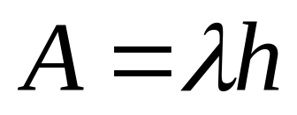
Traffic Intensity
Load presented to a system:
    λ = mean rate of calls attempted per unit time
    h = mean holding time per successful call
    A = average number of calls arriving during average holding period
Wireless Networks Spring 2005

Slide 20
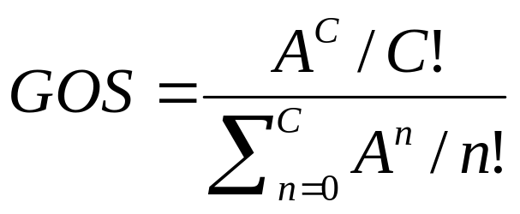
Capacity in Cellular Systems
Blocking Probability (Grade Of Service): Erlang B formula
Based on the above formula, we can determine the minimum N needed to support a desired grade of service.
Wireless Networks Spring 2005

Slide 21
Factors that Determine the Nature of the Traffic Model
Manner in which blocked calls are handled
  Lost calls delayed (LCD) – blocked calls put in a queue awaiting a free channel
  Blocked calls rejected and dropped
    Lost calls cleared (LCC) – user waits before another attempt
    Lost calls held (LCH) – user repeatedly attempts calling
Number of traffic sources
  Whether number of users is assumed to be finite or infinite
Wireless Networks Spring 2005

Slide 22
First-Generation Analog
Advanced Mobile Phone Service (AMPS)
  In North America, two 25-MHz bands allocated to AMPS
    One for transmission from base to mobile unit
    One for transmission from mobile unit to base
  Each band split in two to encourage competition (12.5MHz per operator)
  Channels of 30 KHz: 21 control channels (FSK), 395 traffic channels (FM voice) per operator
  Frequency reuse exploited (R = 7)
Wireless Networks Spring 2005

Slide 23
AMPS Operation
Subscriber initiates call by keying in phone number and presses send key
MTSO verifies number and authorizes user
MTSO issues message to user’s cell phone indicating send and receive traffic channels
MTSO sends ringing signal to called party
Party answers; MTSO establishes circuit and initiates billing information
Either party hangs up; MTSO releases circuit, frees channels, completes billing
Wireless Networks Spring 2005

Slide 24
Differences Between First and Second Generation Systems
Digital traffic channels – first-generation systems are almost purely analog; second-generation systems are digital
Encryption – all second generation systems provide encryption to prevent eavesdropping
Error detection and correction – second-generation digital traffic allows for detection and correction, giving clear voice reception
Channel access – second-generation systems allow channels to be dynamically shared by a number of users
Wireless Networks Spring 2005

Slide 25
TDMA Design Considerations
Number of logical channels per physical channel (number of time slots in TDMA frame): 8
Maximum cell radius (R): 35 km
Frequency: region around 900 MHz
Maximum vehicle speed (V_{m}):250 km/hr
Maximum coding delay: approx. 20 ms
Maximum delay spread (Δ_{m}): 10 μs
Bandwidth: Not to exceed 200 kHz (25 kHz per channel)
Wireless Networks Spring 2005

Slide 26
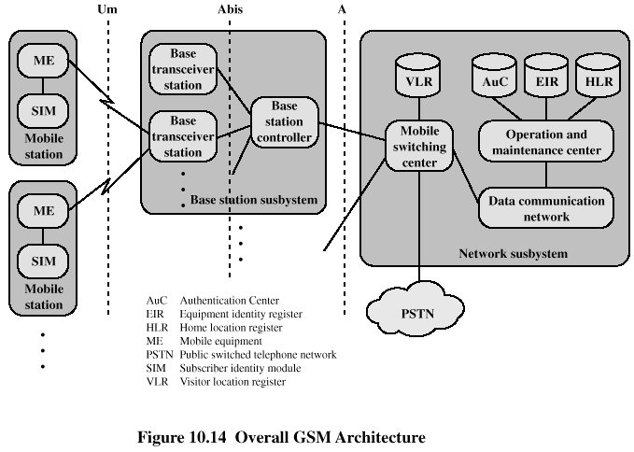
GSM Network Architecture

Slide 27
Architecture of the GSM system
Several providers setup mobile networks following the GSM standard within each country
Components
  MS (mobile station)
  BS (base station)
  MSC (mobile switching center)
  LR (location register)
Subsystems
  RSS (radio subsystem): covers all radio aspects
    Base station subsystem
  NSS (network and switching subsystem): call forwarding, handover, switching
  OSS (operation subsystem): management of the network
Wireless Networks Spring 2005

Slide 28
GSM: elements and interfaces
radio cell
MS
MS
BSS
U_{m}
radio cell
RSS
BTS
MS
BTS
A_{bis}
BSC
BSC
A
MSC
MSC
NSS
VLR
VLR
signaling
HLR
GMSC
ISDN, PSTN
IWF
PDN
O
OSS
EIR
AUC
OMC
Wireless Networks Spring 2005

Slide 29
GSM: system architecture
radio
subsystem
network and switching subsystem
Fixed partner networks
MS
MS
ISDN
PSTN
U_{m}
MSC
BTS
A_{bis}
BTS
BSC
EIR
SS7
HLR
BTS
VLR
BSC
ISDN
PSTN
BTS
A
MSC
BSS
IWF
PDN
Wireless Networks Spring 2005

Slide 30
Radio subsystem
Components
  MS (Mobile Station)
  BSS (Base Station Subsystem):
  consisting of
    BTS (Base Transceiver Station):
    sender and receiver
    BSC (Base Station Controller):
    controlling several transceivers
Interfaces
  U_{m} : radio interface
  A_{bis} : standardized, open interface with
  16 kbit/s user channels
  A: standardized, open interface with
  64 kbit/s user channels
radio
subsystem
network and switching
subsystem
MS
MS
U_{m}
BTS
A_{bis}
BSC
MSC
BTS
A
BTS
MSC
BTS
BSC
BSS
Wireless Networks Spring 2005

Slide 31
Mobile Station
Mobile station communicates across Um interface (air interface) with base station transceiver in same cell as mobile unit
Mobile equipment (ME) – physical terminal, such as a telephone or PDA
  ME includes radio transceiver, digital signal processors and subscriber identity module (SIM)
GSM subscriber units are generic until SIM is inserted
  SIMs roam, not necessarily the subscriber devices
Wireless Networks Spring 2005

Slide 32
Base Station Subsystem (BSS)
BSS consists of base station controller and one or more base transceiver stations (BTS)
Each BTS defines a single cell
  Includes radio antenna, radio transceiver and a link to a base station controller (BSC)
BSC reserves radio frequencies, manages handoff of mobile unit from one cell to another within BSS, and controls paging
Wireless Networks Spring 2005

Slide 33
Network and switching subsystem
network
subsystem
fixed partner
networks
Components
  MSC (Mobile Services Switching Center):
  IWF (Interworking Functions)
  ISDN (Integrated Services Digital Network)
  PSTN (Public Switched Telephone Network)
  PSPDN (Packet Switched Public Data Net.)
  CSPDN (Circuit Switched Public Data Net.)
Databases
  HLR (Home Location Register)
  VLR (Visitor Location Register)
  EIR (Equipment Identity Register)
ISDN
PSTN
MSC
EIR
SS7
HLR
VLR
MSC
ISDN
PSTN
IWF
PSPDN
CSPDN
Wireless Networks Spring 2005

Slide 34
Network Subsystem (NS)
Provides link between cellular network and PSTNs
Controls handoffs between cells in different BSSs
Authenticates users and validates accounts
Enables worldwide roaming of mobile users
Central element of NS is the mobile switching center (MSC)
Wireless Networks Spring 2005

Slide 35
Mobile Switching Center (MSC) Databases
Home location register (HLR) database – stores information about each subscriber that belongs to it
Visitor location register (VLR) database – maintains information about subscribers currently physically in the region
Authentication center database (AuC) – used for authentication activities, holds encryption keys
Equipment identity register database (EIR) – keeps track of the type of equipment that exists at the mobile station
Wireless Networks Spring 2005

Slide 36
TDMA Format – Time Slot Fields
Trail bits – allow synchronization of transmissions from mobile units located at different distances
Encrypted bits – encrypted data
Stealing bit - indicates whether block contains data or is "stolen"
Training sequence – used to adapt parameters of receiver to the current path propagation characteristics
  Strongest signal selected in case of multipath propagation
Guard bits – used to avoid overlapping with other bursts
Wireless Networks Spring 2005

Slide 37
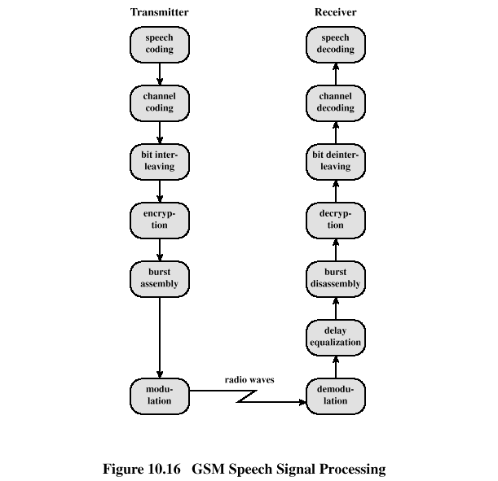
GSM Speech Processing

Slide 38
GSM Speech Processing Steps
Speech compressed using a predictive coding scheme
Divided into blocks, each of which is protected partly by CRC and partly by a convolutional code
Interleaving to protect against burst errors
Encryption for providing privacy
Assembled into time slots
Modulated for analog transmission using FSK
Wireless Networks Spring 2005

Slide 39
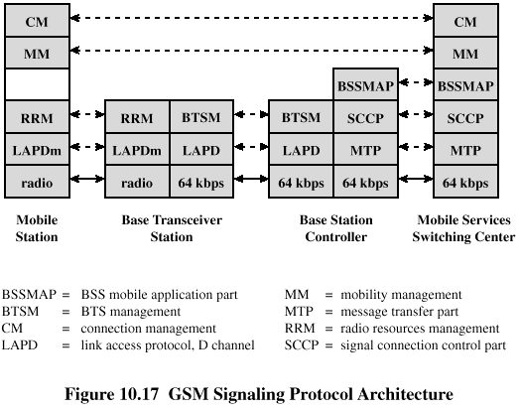
GSM Signaling Protocol

Slide 40
Functions Provided by Protocols
Protocols above the link layer of the GSM signaling protocol architecture provide specific functions:
  Radio resource management
  Mobility management
  Connection management
  Mobile application part (MAP)
  BTS management
Wireless Networks Spring 2005

Slide 41

Mobile Terminated Call
1: calling a GSM subscriber
2: forwarding call to GMSC
3: signal call setup to HLR
4, 5: connect with current VLR
6: forward responsible
MSC to GMSC
7: forward call to current MSC
8, 9: get current status of MS
10, 11: paging of MS
12, 13: MS answers
14, 15: security checks
16, 17: set up connection
4
HLR
VLR
5
8
9
3
6
14
15
calling
station
7
PSTN
GMSC
MSC
1
2
10
10
13
10
16
BSS
BSS
BSS
11
11
11
11
12
17
MS
Wireless Networks Spring 2005

Slide 42
Mobile Originated Call
1, 2: connection request
3, 4: security check
5-8: check resources (free circuit)
9-10: set up call
VLR
3
4
6
5
PSTN
GMSC
MSC
7
8
2
9
1
MS
BSS
10
Wireless Networks Spring 2005

Slide 43
MTC/MOC
MS
MTC
BTS
MS
MOC
BTS
paging request
channel request
channel request
immediate assignment
immediate assignment
paging response
service request
authentication request
authentication request
authentication response
authentication response
ciphering command
ciphering command
ciphering complete
ciphering complete
setup
setup
call confirmed
call confirmed
assignment command
assignment command
assignment complete
assignment complete
alerting
alerting
connect
connect
connect acknowledge
connect acknowledge
data/speech exchange
data/speech exchange
Wireless Networks Spring 2005

Slide 44
4 types of handover
1
2
3
4
MS
MS
MS
MS
BTS
BTS
BTS
BTS
BSC
BSC
BSC
MSC
MSC
Wireless Networks Spring 2005

Slide 45
Handover decision
receive level
BTS_{old}
receive level
BTS_{old}
HO_MARGIN
MS
MS
BTS_{old}
BTS_{new}
Wireless Networks Spring 2005

Slide 46
Security in GSM
Security services
  access control/authentication
    user  SIM (Subscriber Identity Module): secret PIN (personal identification number)
    SIM  network: challenge response method
  confidentiality
    voice and signaling encrypted on the wireless link (after successful authentication)
  anonymity
    temporary identity TMSI
    (Temporary Mobile Subscriber Identity)
    newly assigned at each new location update (LUP)
    encrypted transmission
3 algorithms specified in GSM
  A3 for authentication (“secret”, open interface)
  A5 for encryption (standardized)
  A8 for key generation (“secret”, open interface)
“secret”:
A3 and A8 available via the Internet
network providers can use stronger mechanisms
Wireless Networks Spring 2005

Slide 47
GSM - authentication
mobile network
SIM
RAND
K_{i}
RAND
RAND
K_{i}
AC
128 bit
128 bit
128 bit
128 bit
A3
A3
SIM
SRES* 32 bit
SRES 32 bit
MSC
SRES* =? SRES
SRES
32 bit
SRES
K_{i}: individual subscriber authentication key SRES: signed response
Wireless Networks Spring 2005

Slide 48
GSM - key generation and encryption
mobile network (BTS)
MS with SIM
RAND
K_{i}
RAND
RAND
K_{i}
AC
128 bit
128 bit
128 bit
128 bit
SIM
A8
A8
cipher
key
K_{c}
64 bit
K_{c}
64 bit
data
encrypted
data
SRES
BTS
data
MS
A5
A5
Wireless Networks Spring 2005

Slide 49
IS-95 (CdmaOne)
IS-95: standard for the radio interface
IS-41: standard for the network part
Operates in 800MHz and 1900MHz bands
Uses DS-CDMA technology (1.2288 Mchips/s)
Forward link (downlink): (2,1,9)-convolutional code, interleaved, 64 chips spreading sequence (Walsh-Hadamard functions)
Pilot channel, synchronization channel, 7 paging channels, up to 63 traffic channels
Reverse link (uplink): (3,1,9)-convolutional code, interleaved, 6 bits are mapped into a Walsh-Hadamard sequence, spreading using a user-specific code
Tight power control (open-loop, fast closed loop)
Wireless Networks Spring 2005

Slide 50
Advantages of CDMA Cellular
Frequency diversity – frequency-dependent transmission impairments have less effect on signal
Multipath resistance – chipping codes used for CDMA exhibit low cross correlation and low autocorrelation
Privacy – privacy is inherent since spread spectrum is obtained by use of noise-like signals
Graceful degradation – system only gradually degrades as more users access the system
Wireless Networks Spring 2005

Slide 51
Drawbacks of CDMA Cellular
Self-jamming – arriving transmissions from multiple users not aligned on chip boundaries unless users are perfectly synchronized
Near-far problem – signals closer to the receiver are received with less attenuation than signals farther away
Soft handoff – requires that the mobile acquires the new cell before it relinquishes the old; this is more complex than hard handoff used in FDMA and TDMA schemes
Wireless Networks Spring 2005

Slide 52
CDMA Design Considerations
RAKE receiver – when multiple versions of a signal arrive more than one chip interval apart, RAKE receiver attempts to recover signals from multiple paths and combine them
  This method achieves better performance than simply recovering dominant signal and treating remaining signals as noise
Soft Handoff – mobile station temporarily connected to more than one base station simultaneously
Wireless Networks Spring 2005

Slide 53
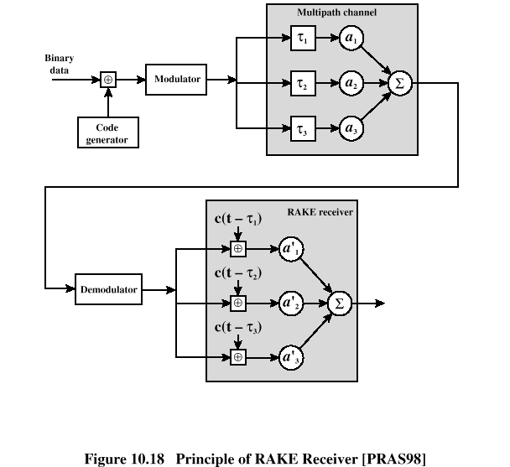
Principle of RAKE Receiver

Slide 54
Forward Link Channels
Pilot: allows the mobile unit to acquire timing information, provides phase reference and provides means for signal strength comparison
Synchronization: used by mobile station to obtain identification information about cellular system
Paging: contain messages for one or more mobile stations
Traffic: the forward channel supports 55 traffic channels
Wireless Networks Spring 2005

Slide 55
Forward Traffic Processing Steps
Speech is encoded at a rate of 8550 bps
Additional bits added for error detection
Data transmitted in 2-ms blocks with forward error correction provided by a convolutional encoder
Data interleaved in blocks to reduce effects of errors
Data bits are scrambled, serving as a privacy mask
  Using a long code based on user’s electronic serial number
Wireless Networks Spring 2005

Slide 56
Forward Traffic Processing Steps
Power control information inserted into traffic channel
DS-SS function spreads the 19.2 kbps to a rate of 1.2288 Mbps using one row of 64 x 64 Walsh matrix
Digital bit stream modulated onto the carrier using QPSK modulation scheme
Wireless Networks Spring 2005

Slide 57
Reverse Traffic Processing Steps
Convolutional encoder at rate 1/3
Spread the data using a Walsh matrix
  Use a 6-bit piece of data as an index to the Walsh matrix
  To improve reception at base station
Data burst randomizer
Spreading using the user-specific long code mask
Wireless Networks Spring 2005

Slide 58
Third-Generation Capabilities
Voice quality comparable to the public switched telephone network
144 kbps data rate available to users in high-speed motor vehicles over large areas
384 kbps available to pedestrians standing or moving slowly over small areas
Support for 2.048 Mbps for office use
Symmetrical/asymmetrical data transmission rates
Support for both packet switched and circuit switched data services
Wireless Networks Spring 2005

